Slide 1


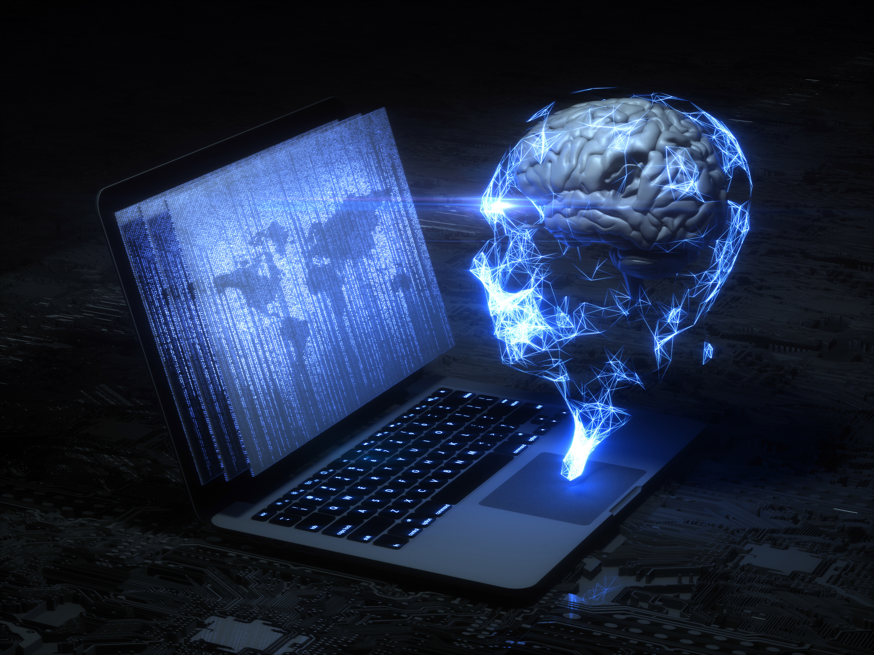



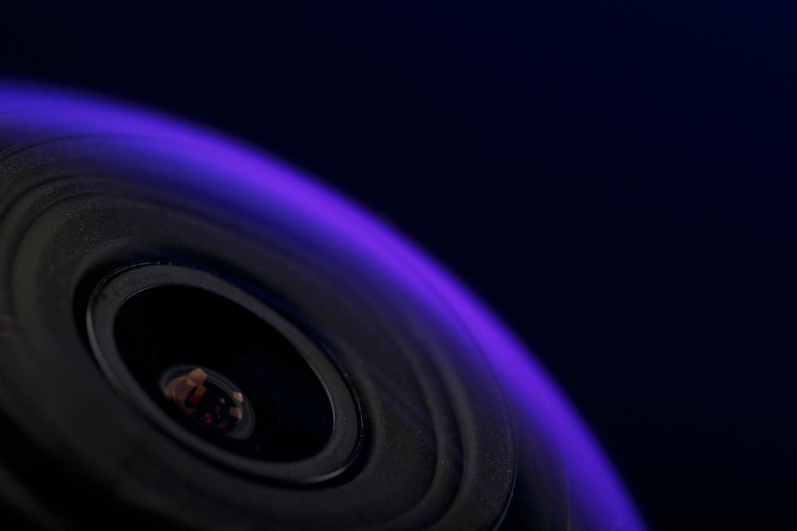

CNN - A CLOSER ANALYSIS OF THE EFFICIENTNET MODEL
IMAGE: OBJECT CLASSIFICATION
KHIN CHAW | KHIN HPONE

Slide 2

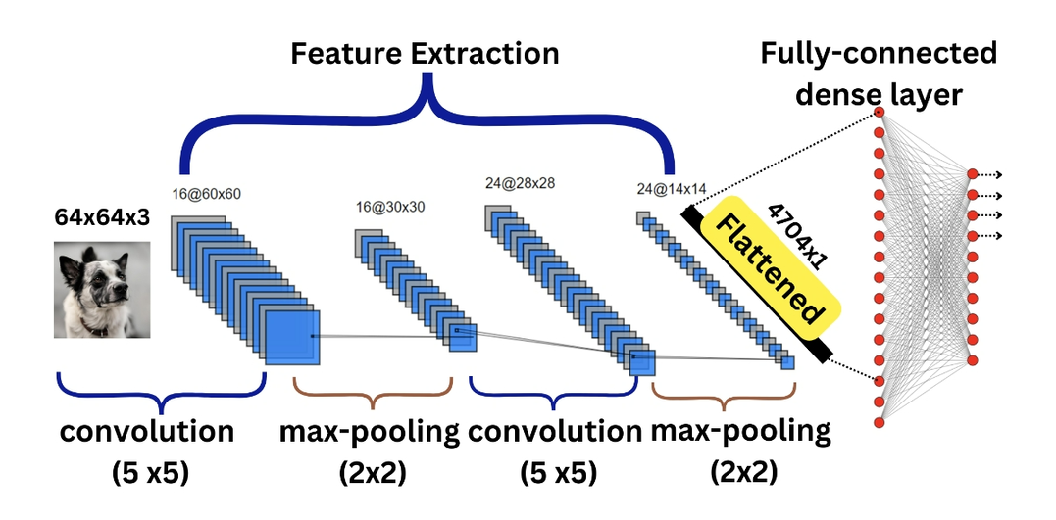
INTRODUCTION
What is a Convolutional Neural Network (CNN)?
A deep learning model specifically designed for processing grid-like data such as images.
CNNs automatically learn spatial hierarchies of features, making them ideal for tasks like image classification, object detection, and segmentation.
Example of CNN

Slide 3
WHAT IS EFFICIENTNET?
EfficientNet is a family of convolutional neural networks developed by Google AI (Tan & Le, 2019).
It introduces a novel compound scaling method that simultaneously scales:
Depth (number of layers)
Width (number of channels)
Input resolution
Aimed at achieving high accuracy with low computational cost.
The EfficientNet family includes models from B0 to B7, where:
B0 is the baseline network,
B1–B7 progressively scale up in size and performance.
https://www.geeksforgeeks.org/computer-vision/efficientnet-architecture/

Slide 4
WHY EFFICIENTNET IS EFFICIENT
Uses MBConv (Mobile Inverted Bottleneck Convolution) with:
Depthwise separable convolution
Squeeze-and-Excitation (SE) blocks
Swish activation (instead of ReLU)
Compound scaling formula:
EfficientNet-B0 is the baseline; B1–B7 are scaled up versions

Slide 5

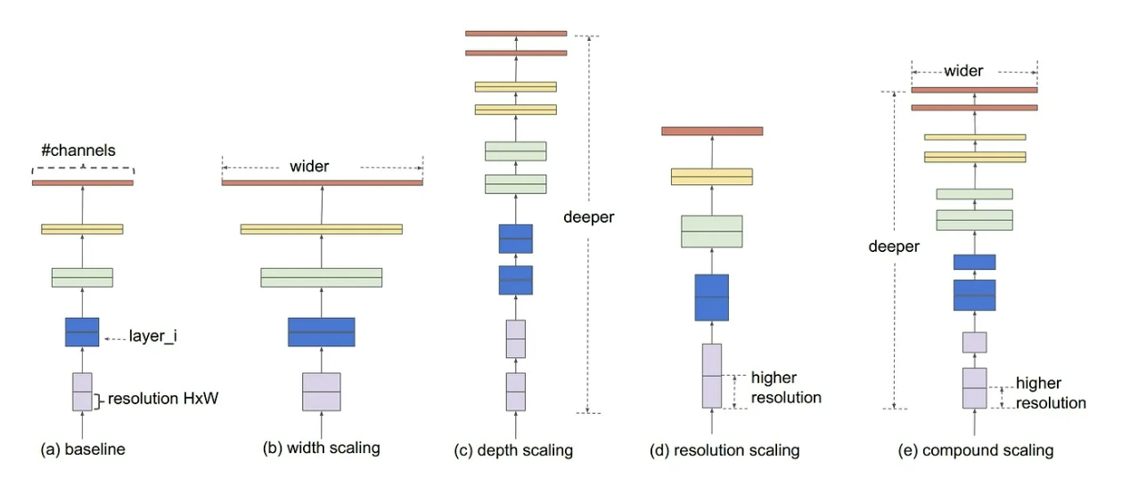

EFFICIENTNET
MODEL SCALING REF:Mingxing Tan and Quoc V. Le. Efficientnet: Rethinking model scaling for convolutional neural networks. In Proceedings of the 36th International Conference on Machine Learning, ICML, pages 6105–6114., 2019.

Slide 6
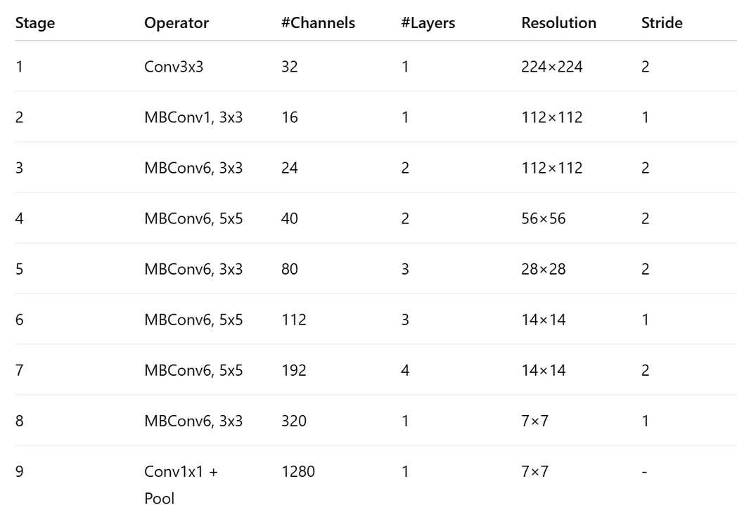
EfficientNet-B0 Layer Structure
ALL CONVOLUTIONAL LAYERS ARE FOLLOWED BY:
– BATCH NORMALIZATION
– SWISH ACTIVATION (BETTER THAN RELU)
MBCONV INCLUDES SE BLOCK (RECALIBRATION OF CHANNELS

Slide 7
EFFICIENTNET
Layer Components
🔹Input Layer
Typically uses 224×224×3 RGB images
Applied normalization and standard resizing
🔹 Stem Layer
3×3 Conv, stride 2, output shape ↓ from 224×224 to 112×112
Uses swish activation function (f(x) = x * sigmoid(x))
🔹 MBConv Blocks (Mobile Inverted Bottleneck Convolution)
Each block includes:
1×1 Pointwise conv (expansion)
3×3 or 5×5 Depthwise conv
1×1 Pointwise conv (projection)
Squeeze-and-Excitation (SE) block (channel-wise recalibration)
Replaces traditional convolutions blocks for better efficiency
🔹 Final Layers
1×1 Conv → Global Average Pooling → Dropout → Fully Connected Layer (e.g., 1000-class for ImageNet)

Slide 8
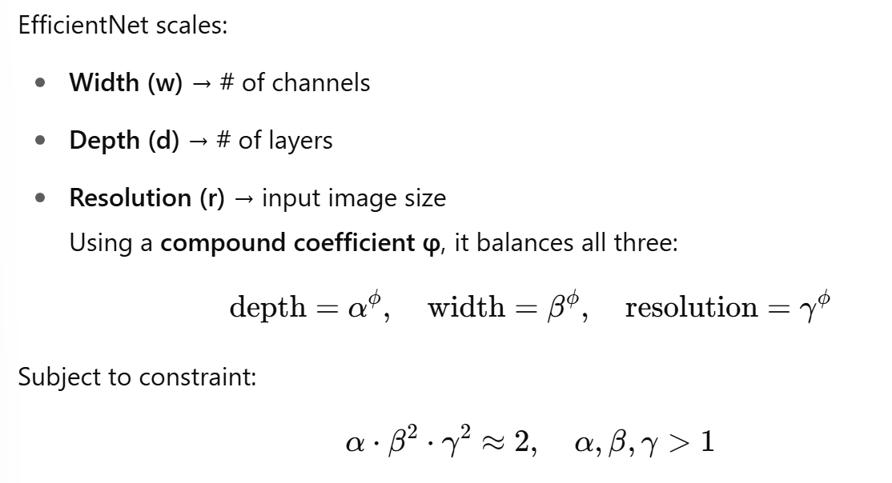
Compound Scaling

Slide 9
Compound Scaling in Action
Width scaling: Adds more channels per layers
Depth scaling: Adds more layers
Resolution scaling: Increases input image size
Compound scaling is more balanced and effective than scaling one factor alone.
“https://www.tensorflow.org/api_docs/python/tf/keras/applications/EfficientNetB0

Slide 10
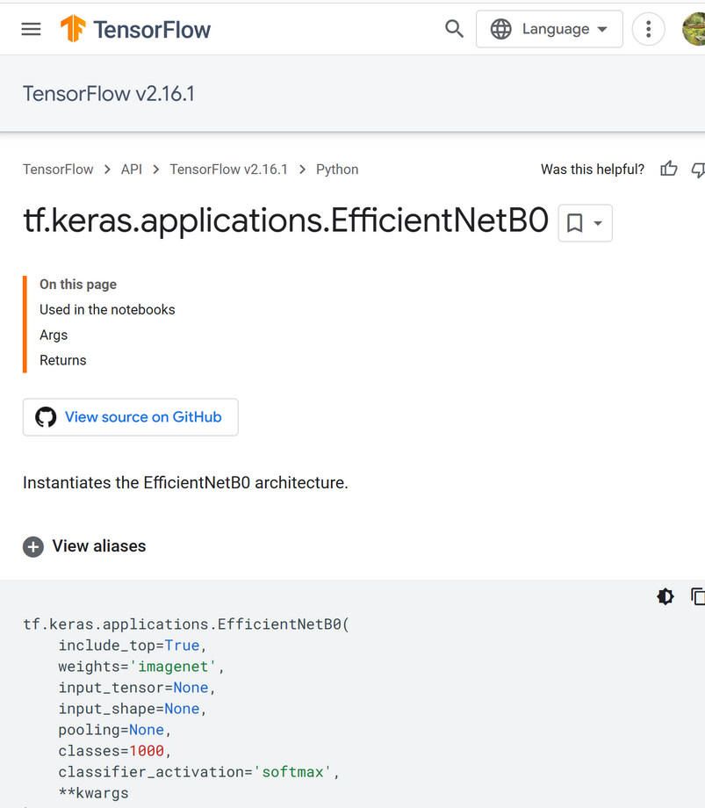
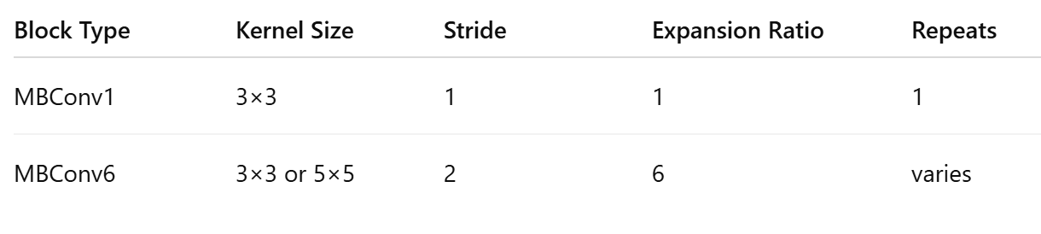
Kernel Sizes & Configurations
Varies across EfficientNet-B0 to B7.
Each version (B0 to B7) increases model capacity by scaling depth, width, and resolution using compound scaling
Depth-wise separable convolutions reduce FLOPs (Floating Point Operations), reduces model size & parameters, maintains high accuracy.
“https://www.tensorflow.org/api_docs/python/tf/keras/applications/EfficientNetB0

Slide 11
LIMITATIONS
Higher inference time on CPU-only environments
Difficult to customize compared to plain CNNs due to compound scaling
SE blocks and Swish activation are computationally expensive, especially on edge/mobile devices
Use Cases & Applications
Best suited for high-accuracy tasks where sufficient resources are available
Applied in: medical imaging (e.g., tumor detection), retail product detection, mobile apps (EffNet-Lite)

Slide 12
Project Overview
Comparative Study of CNN Architectures for Image Classification : Focusing on EfficientNet
explored the performance of five popular Convolutional Neural Network (CNN) architectures using Python and Keras.
The models used are: ResNet50, VGG16, InceptionV3, ConvNeXt-Tiny, and EfficientNetB7.
used a dataset of 40 images (20 real and 20 synthetic) to test the EfficientNet model.
GOAL
TO COMPARE EACH MODEL’S PERFORMANCE IN TERMS OF
PREDICTION ACCURACY, INFERENCE SPEED, AND PRACTICAL USABILITY.

Slide 13


MICROSOFT
IMAGE GENERATOR
DATASET
The dataset contains:
20 real images collected from the internet
20 synthetic images generated by Microsoft’s AI image generator
Real images vary in size; synthetic images are fixed at 1024 × 1024 pixels.
All images were preprocessed and resized to fit model’s input shape .
Microsoft. Microsoft image creator. "https://designer.microsoft.com/image-creator", 2025.

Slide 14
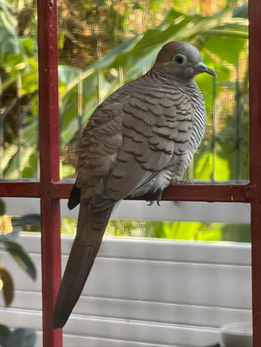
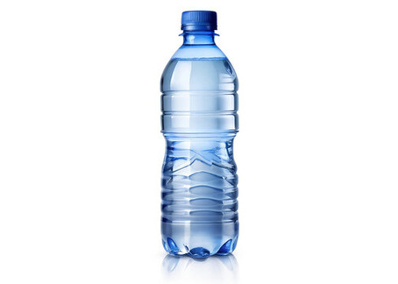
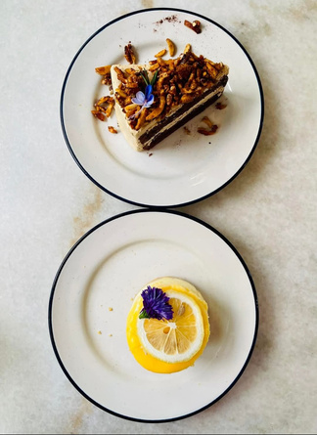
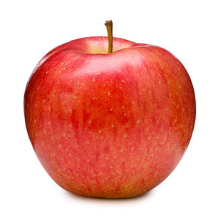
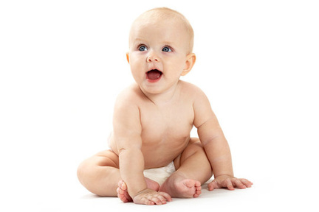
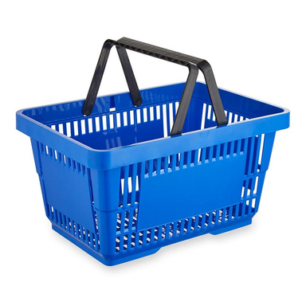
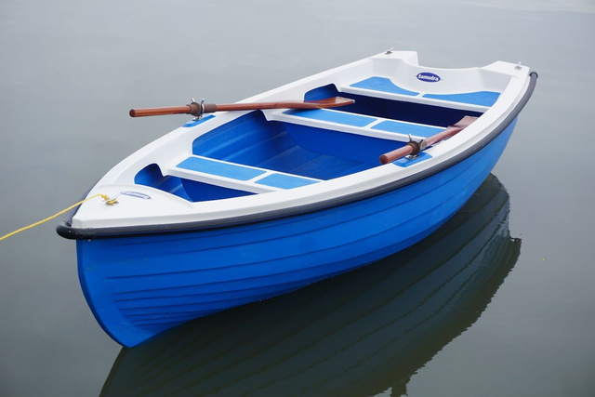
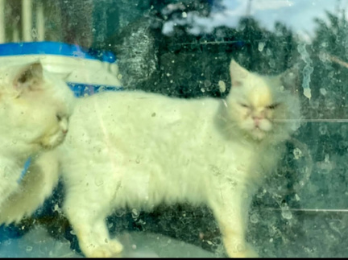


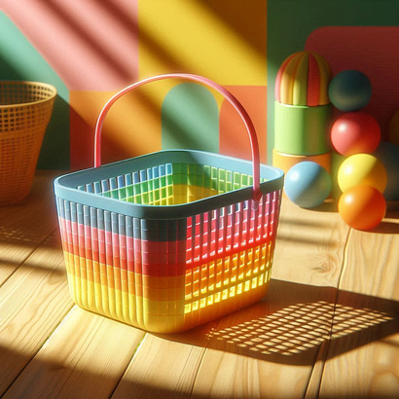





DATASET-REAL AND SYNTHETIC

Slide 15
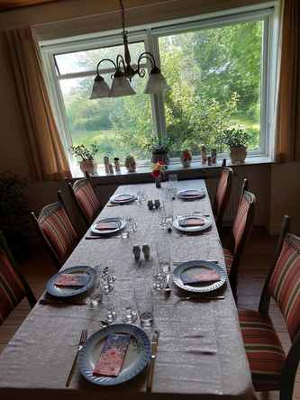
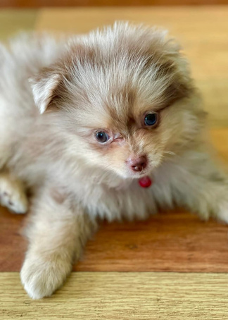

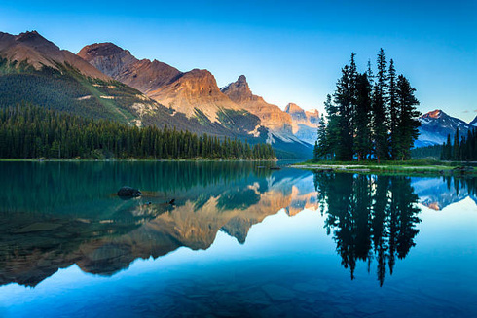
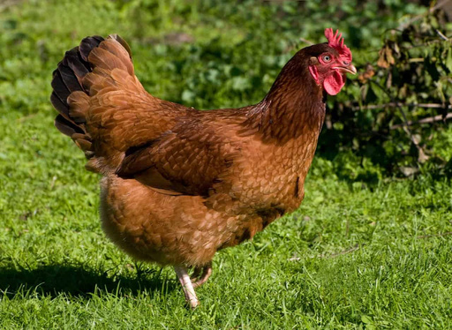
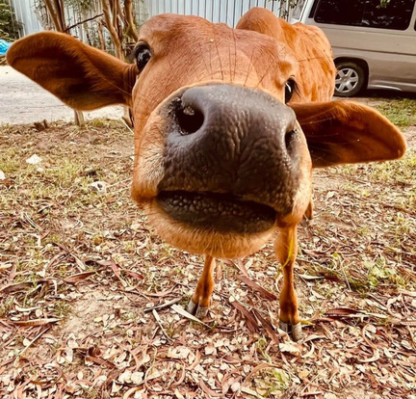

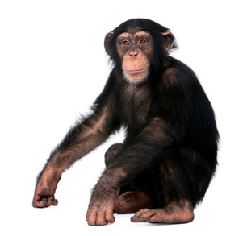
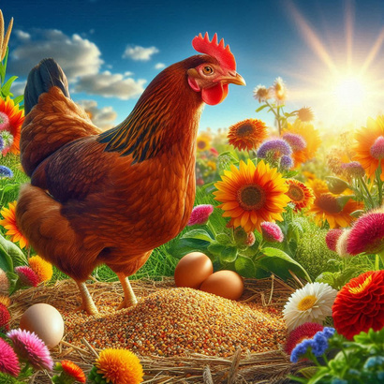
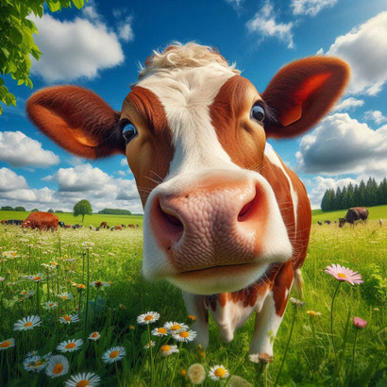
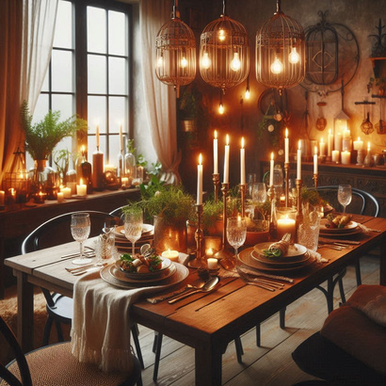
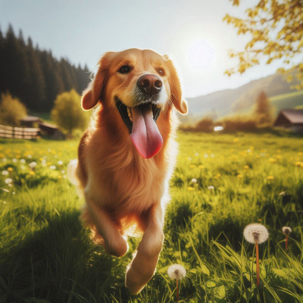




DATASET-REAL AND SYNTHETIC

Slide 16
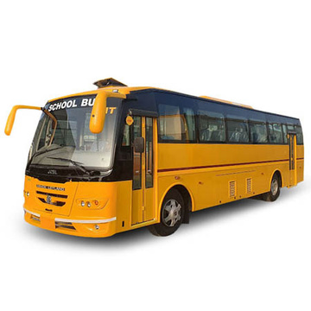
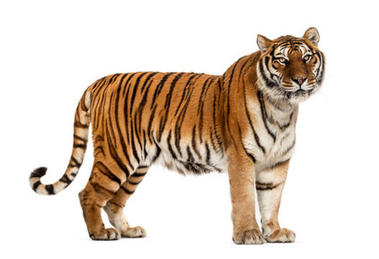
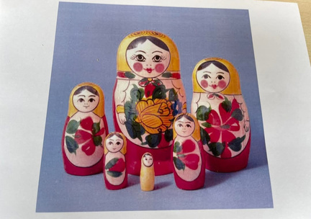
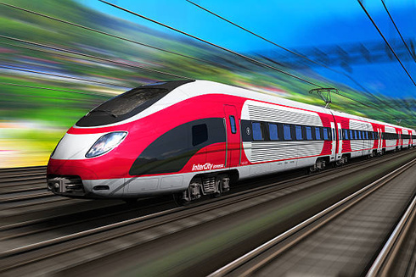


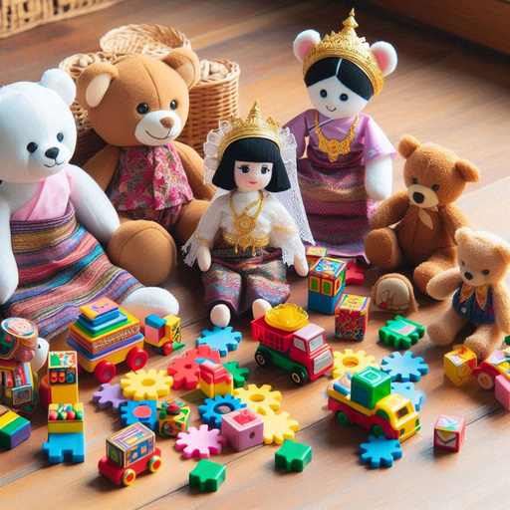

DATASET-REAL AND SYNTHETIC

Slide 17
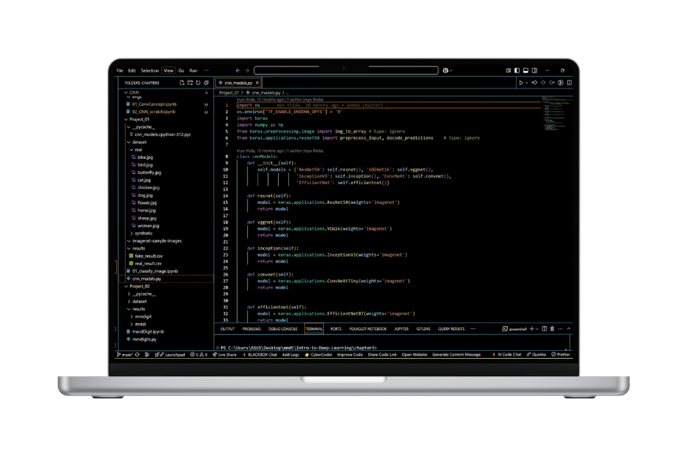
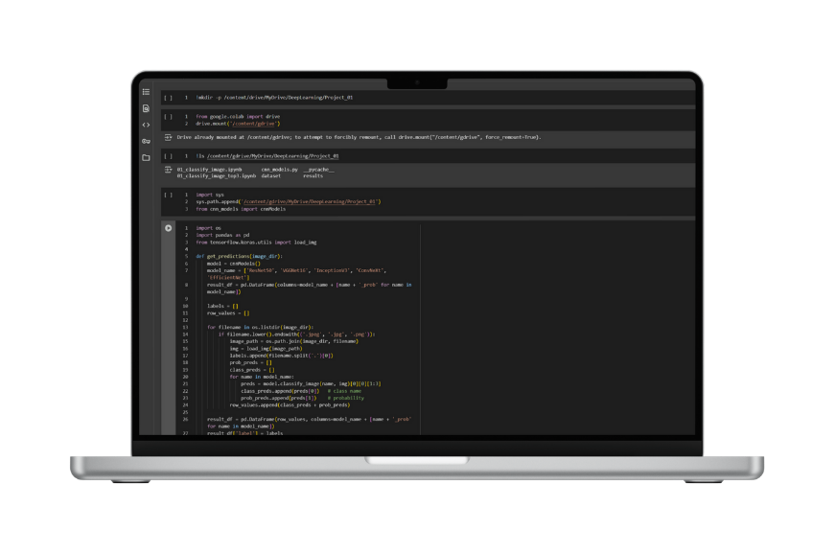
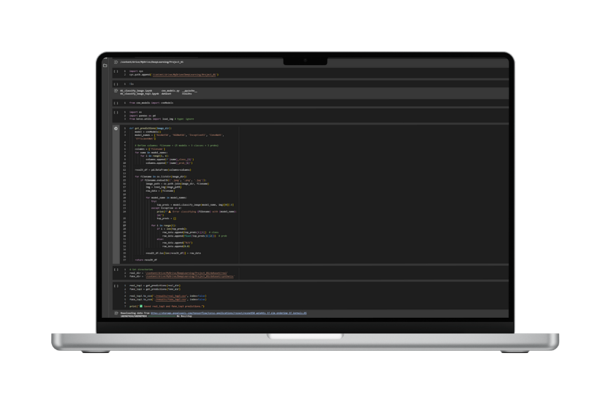
EXPERIMENT
• All models were pre-trained on the ImageNet dataset using Keras.
time.perf_counter() was used to calculate per-image inference time.
Predictions were decoded using decode_predictions() to get top-3 results.

Slide 18
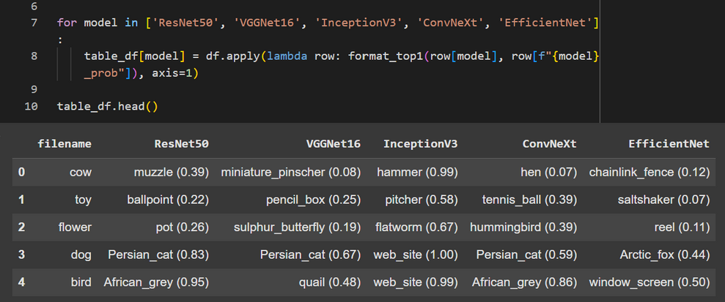
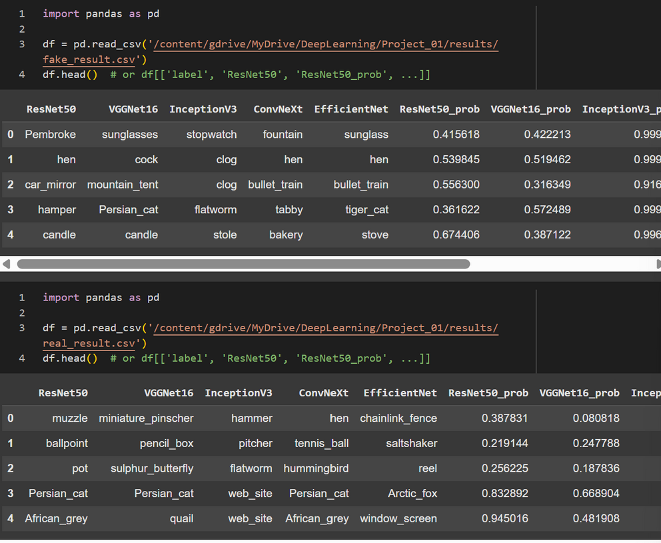
IMAGE CLASSIFICATION

Slide 19
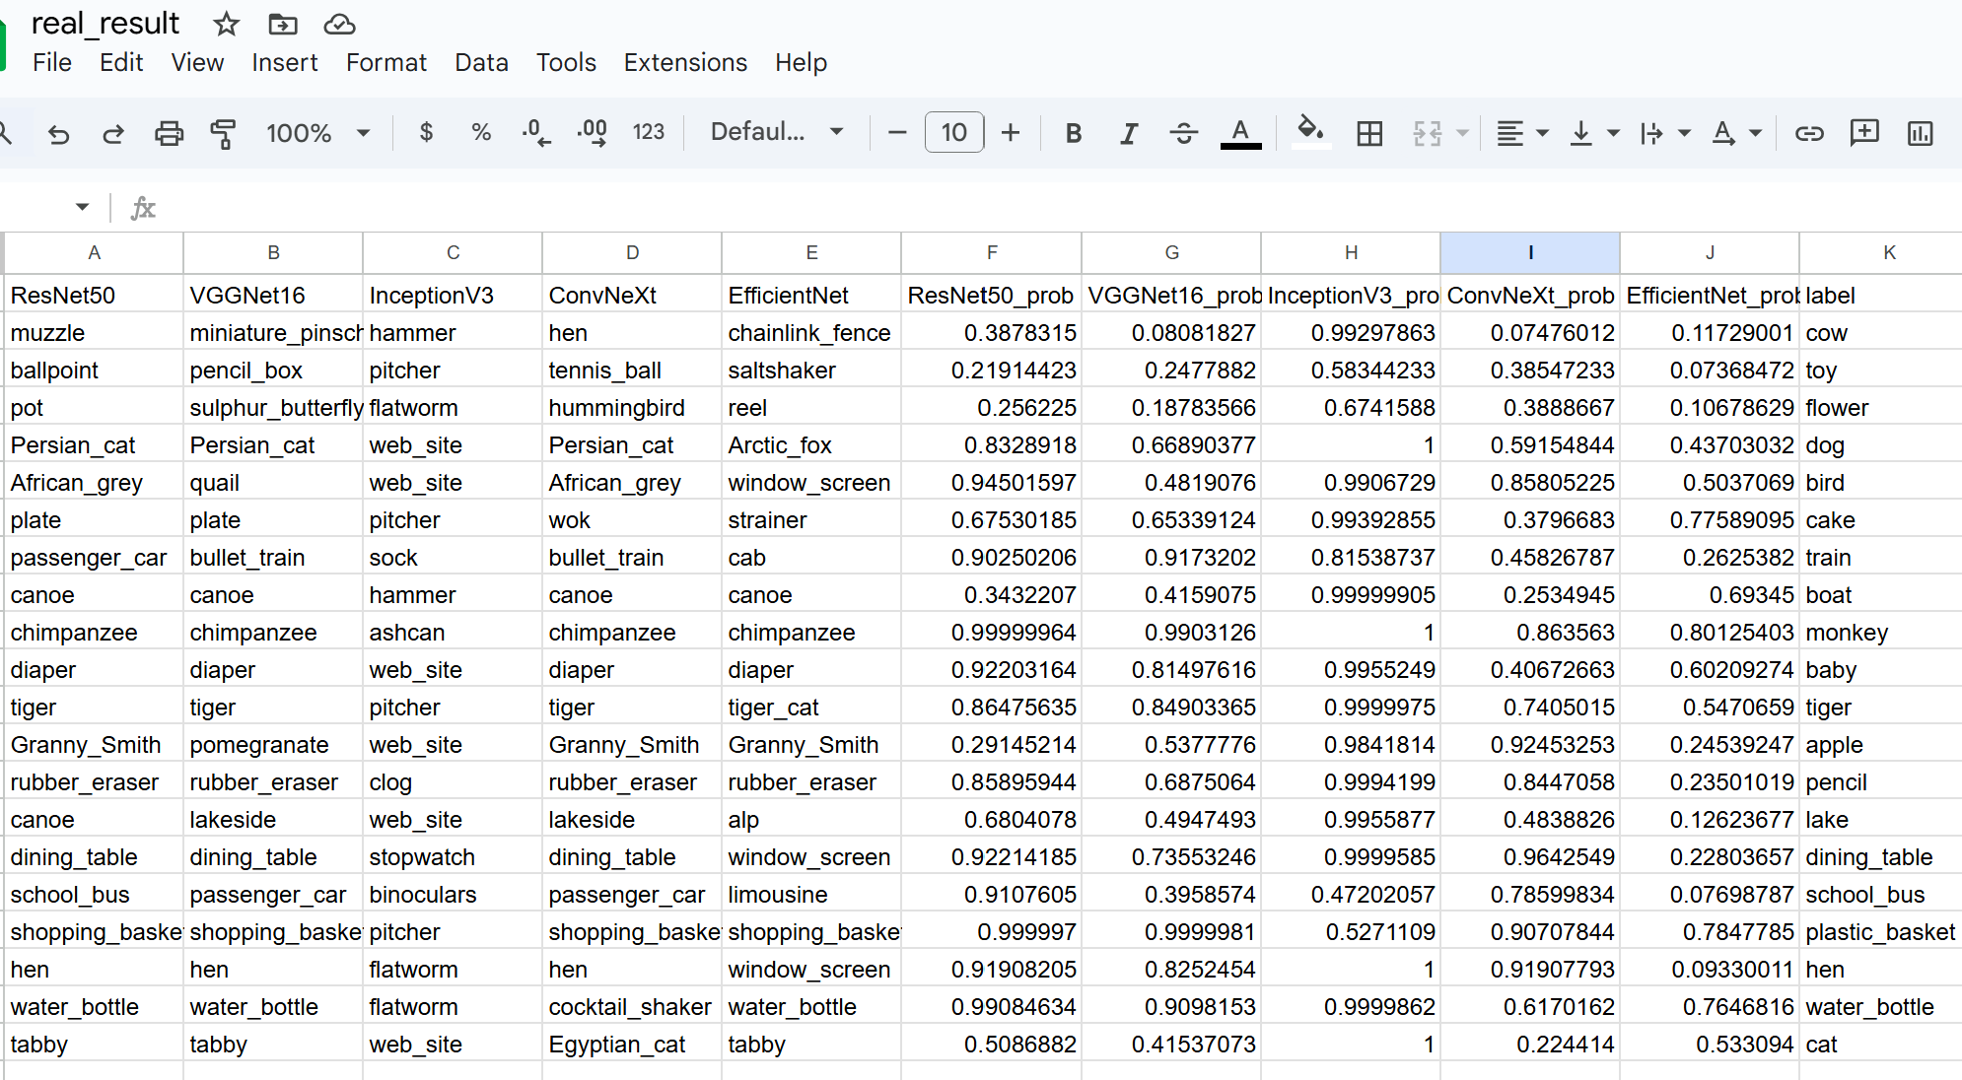
IMAGE CLASSIFICATION: REAL

Slide 20
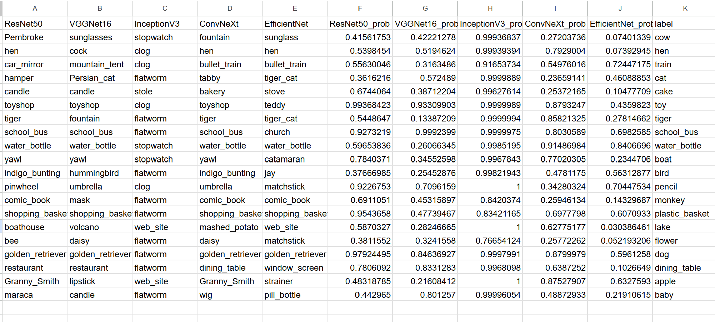
IMAGE CLASSIFICATION: FAKE

Slide 21
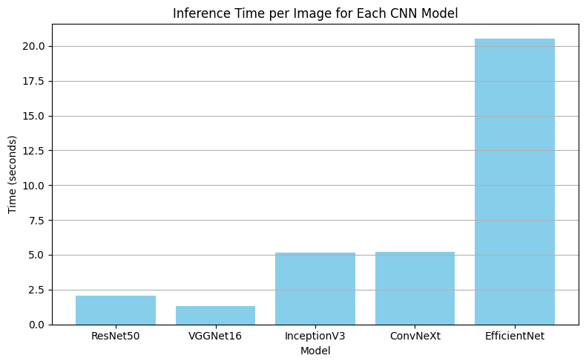
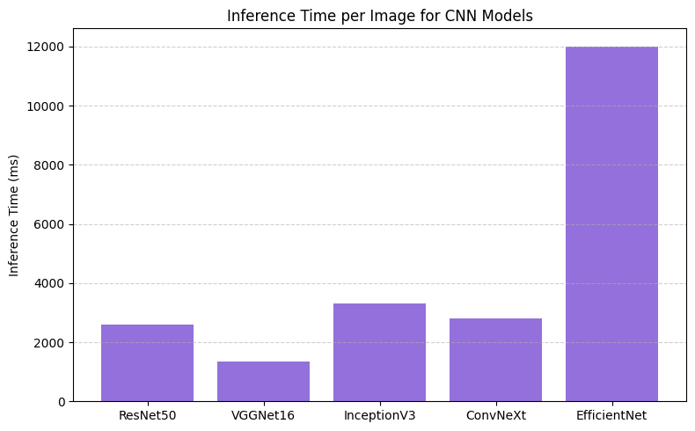
Inference Time per Image
Fastest: VGGNet16 (~1s)
Slowest: EfficientNet (~11s)
Observation: EfficientNet, while being accurate in some cases, had the longest inference time.

Slide 22
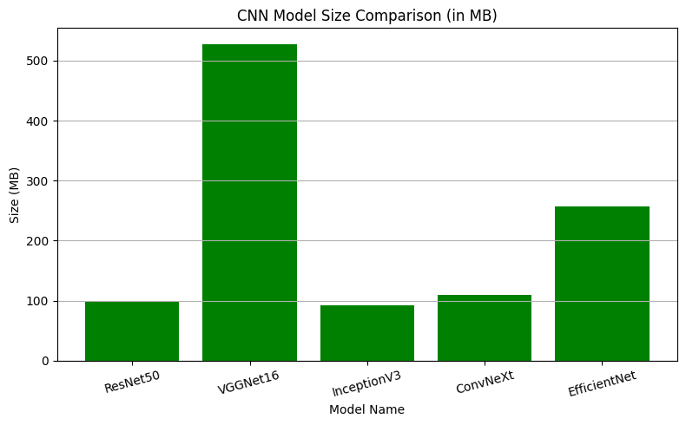
Model size and Memory footprint
Model | File Size (MB)
ResNet50 | 98.35
VGG16 | 527.87
InceptionV3 | 91.93
ConvNexXt-Tiny | 109.53
EfficientNetB7 | 256.59
Smallest: ResNet50 (~98 MB)
Largest: VGGNet16 (~528 MB)
Observation: VGGNet16 is over 5x the size of ResNet50 with only slightly better accuracy.

Slide 23
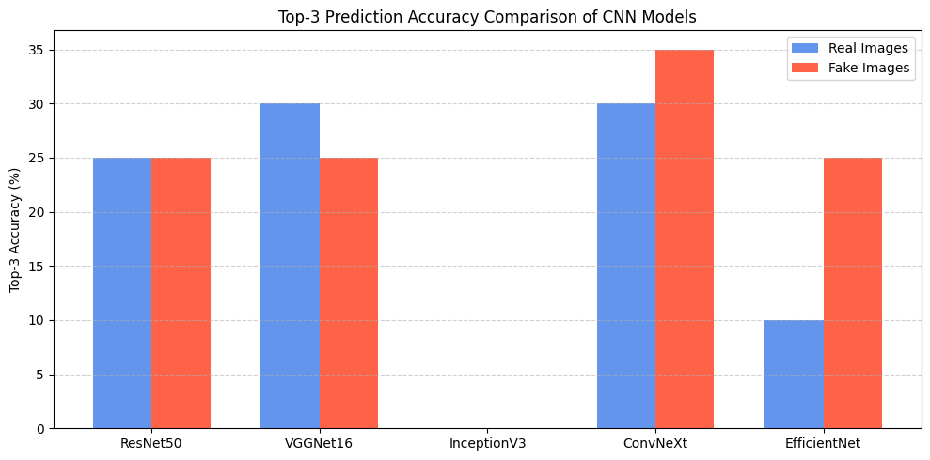
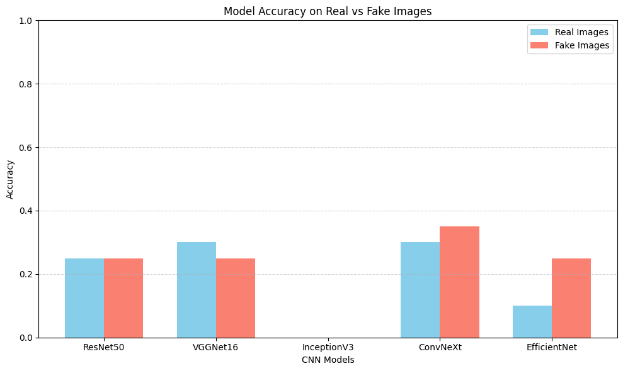
MODEL ACCURACY
ConvTeXt-Tiny is close with good trade-off between accuracy and speed.

Slide 24
Results & Discussion
Prediction Accuracy (Soft Match)
ResNet50: Real = 25%, Fake = 25%
VGGNet16: Real = 30%, Fake = 25%
InceptionV3: Real = 0%, Fake = 0%
ConvNeXt: Real = 30%, Fake = 35%
EfficientNet: Real = 10%, Fake = 25%
Observation: ConvNeXt showed the highest accuracy for fake images (35%) and tied with VGGNet16 on real (30%). InceptionV3 failed to recognize both.

Slide 25
FINDINGS
InceptionV3 has high confidence but 0% accuracy, indicating it is confidently wrong.
ResNet50 is the most balanced in terms of accuracy and confidence.
ConvNeXt performs best on fake images in both accuracy and confidence.
EfficientNet has the lowest average confidence and performs poorly.

Slide 26
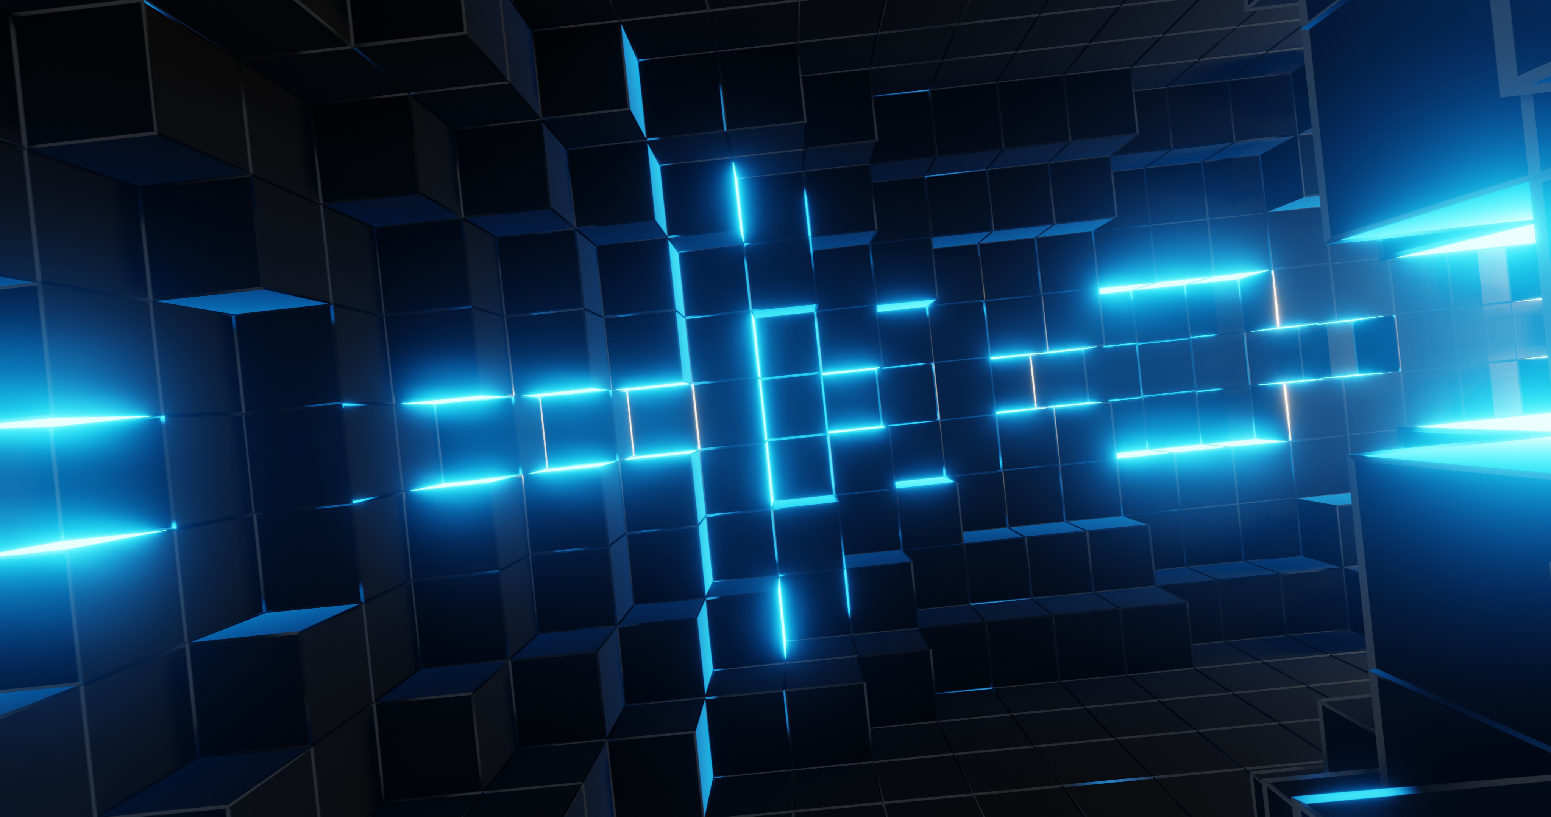
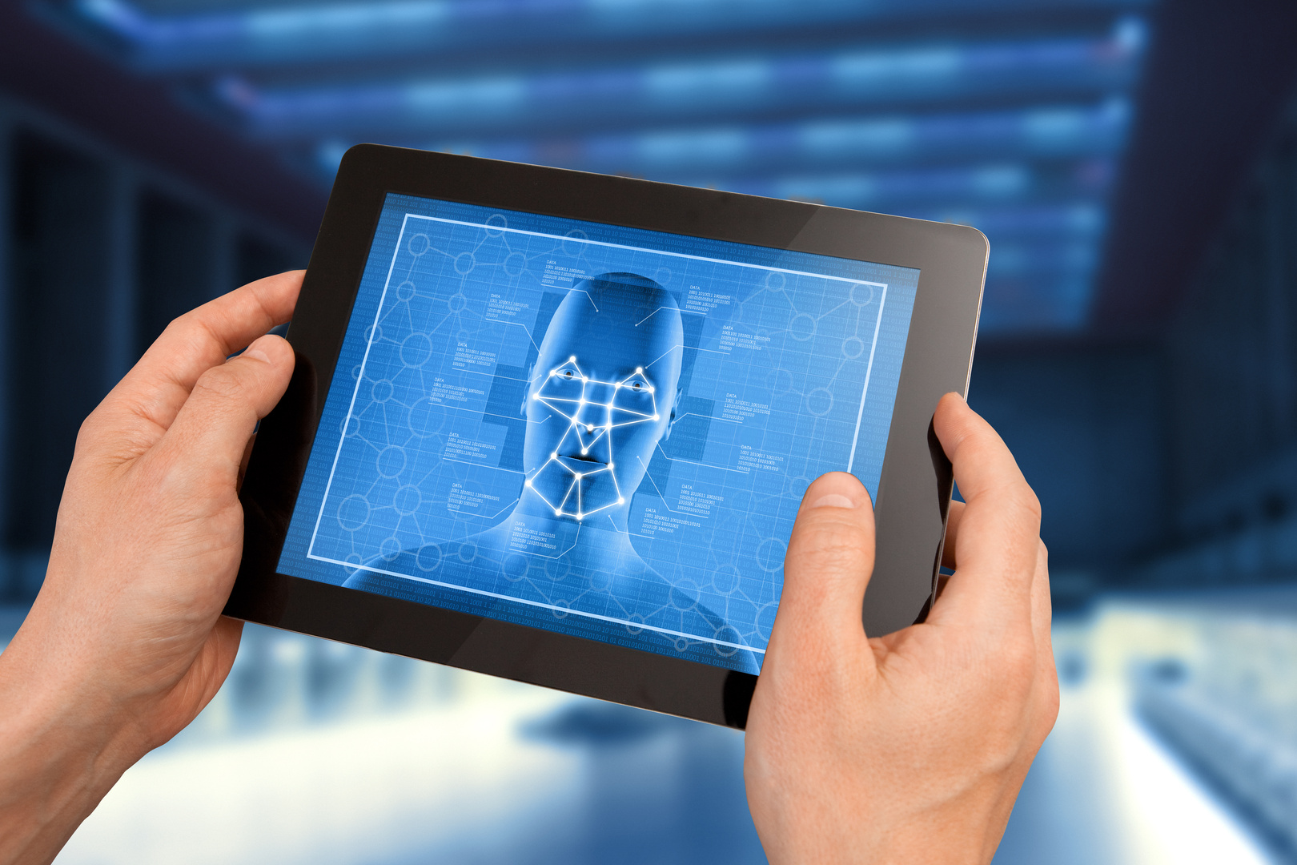
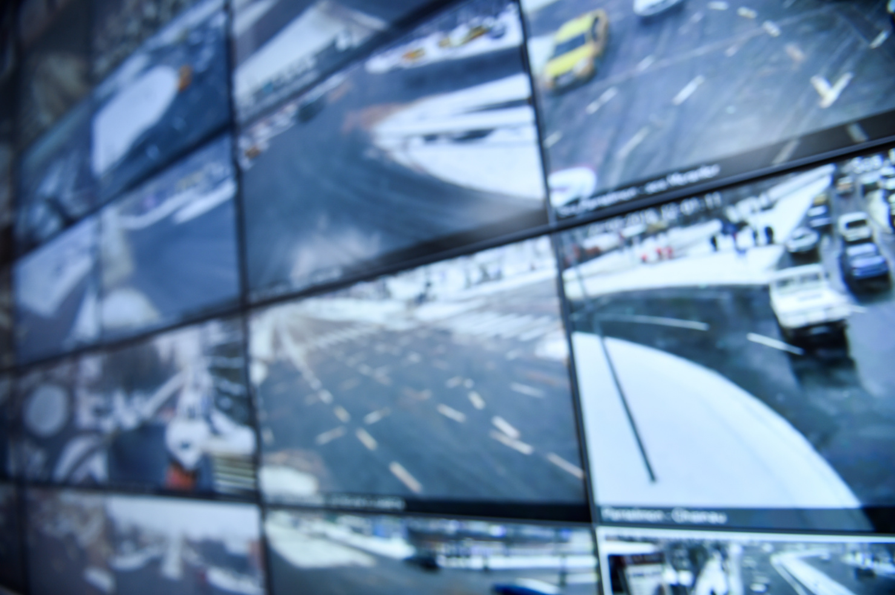

Limitations
Small dataset: Limited number of images used for evaluation
No fine-tuning: All models used pre-trained ImageNet weights without custom training
Limited evaluation metric: Only soft match accuracy and top-3 predictions were used
No qualitative error analysis: Misclassified images not visually inspected

Slide 27
Future Work
Expand dataset size and diversity for more reliable benchmarking
Fine-tune models on a custom dataset to increase domain-specific performance
Include more evaluation metrics: Precision, Recall, F1-score
Test on difFERent image types (e.g., grayscale, occluded, rotated) for robustness
Deploy models in a simple web or mobile app for interactive testing

Slide 28

CONCLUSION
Best Overall Tradeoff: ConvNeXt — highest accuracy (real: 30%, fake: 35%) and moderate inference time and size
Best for Speed: VGGNet16 — fastest inference, but very large size
Worst Performer: InceptionV3 — 0% accuracy despite moderate speed and size
Insight: Model size doesn't directly correlate with accuracy or speed

Slide 29
CNN - A CLOSER ANALYSIS OF THE EFFICIENTNET MODEL
IMAGE: OBJECT CLASSIFICATION
KHIN CHAW | KHIN HPONE

